Slide 1
BIG QUESTION
Where do you work?
What do you do?

Slide 2

FINANCIAL CONSULTANT COMPANY & REAL ESTATE AGENT

Slide 3
TABLE OF CONTENT
About us.
Our Mission & Vision.
Our Goals
Our service.

Slide 4
ABOUT US.
JEN CAPITAL LIMITED, is the registered financial consultancy company in Tanzania, with head office located in Dodoma Tanzania. Is the great company in financial issues and Real estate issues ,a very up to date company. It has a team of 15 people with different skills in Accounting, Auditing, Tax, Advisory, Brela Issues and Real estate. The company has got the great experience of over 5 years in business up to now. We are in different regions of Tanzania including Dodoma, Arusha, Dar Es Salaam, Mwanza, Kilimanjaro, Karatu, Shinyanga.
YES, we are the company that can stand with client in every situation. We are always there for our clients. There is no problem without a solution. That Is why we believe in our motto which says Impossible is Possible.

Slide 5
MISSION
To provide the best and permanent financial solution to the chronicle financial problems for our clients and to give the best service to our real estate clients.

Slide 6
VISION.
To become the best international financial consultancy company, with open hands to all clients with financial problems and to provide full real estate services dedicated to making the buying ,selling and renting of real estate as cost effective as possible.

Slide 7
OUR GOALS.
JEM CAPITAL LIMITED was established to provide high quality and professional services to our clients.
We provide the full range of financial advisory services that is to assist clients in meeting their financial goals by reviewing their assets, debts, income and expenses.
We also manage our clients' investments and offer them with personalized advice to help them understand how to best manage their investments.
Our main goal is finding new ways to serve our clients.
We make it our duty to train ourselves and recruit competent specialists in new areas so that we can provide clients with the high-quality service that exceed their expectation.

Slide 8
OUR SERVICE
Audit & assurance,
Tax consultation.
Accounting services.
Quick book training and installation.
Advanced excel training.
BRELA services.
Budgeting preparation.
Project management.
EFD Machine .(Selling, repair & maintenance)
Real Estate.
Trainings.

Slide 9
AUDIT AND ASSURANCE
AUDIT – is the process of evaluating the accounting entries present in the financial statement.
ASSURANCE – is the process of analyzing accounting entries and financial records.
Our audit services are focusing on client’s business risks. When the risk is properly managed, organization can concentrate and focus on achieving their strategic objectives and goals. We provide audit and assurance services in Tanzania to Companies , Non-government organization (NGOs) and SME (small medium – sized enterprises).
Our audit services are falling under the following,
External Audit.
Internal audit.
Stock/Inventory Audit.
Donors funds audit.

Slide 10
TAX CONSULTATION
JEM CAPITAL LIMITED, we provide tax services in Tanzania for companies, NGO’S, SME and individuals. We help them manage their tax liability and reduce tax exposure.
We serve our clients with the following when it comes to tax issues;
TO ACT. On behalf of the client(s) once TRA (Tanzania Revenue Authority) raise some concerns which need to be taken care immediately.
VAT. For both companies and entrepreneurs who are liable with VAT, we prepare and submit the company’s or individuals VAT return before 20th of every month.
PROVISION TAX. First, we give advice to the tax payer to know reasons of paying, because it is vital importance for the tax payer to know reasons of why they have to comply with the said tax and how much they have to pay before they fall due, once we they are registered. Then we hep them to prepare and submit the accounts in respect with accounting period.

Slide 11
TAX CONSULTATION
4. WITHHOLDING TAX. Since many companies, NGOs and schools face challenges of how to comply with this type of tax and why they have to, we can be of a big assistance to the companies, NGOs and schools to make sure this type of tax is complied properly and according to tax laws.
5. PAYE, SDL, WCF, NSSF, SERVICE LEVY, and etc. this are small taxes and fees that the companies, schools, NGOs and entrepreneurs have to put in mind that they are very miner expenses with huge impact to the businesses particularly.
When a tax payer doesn’t comply or delay submission. We will make sure you don’t skip or delay any submission and we will be there as your reminder, as well as preparing and filling them for you before due to dates.
NOTE: not all companies, NGOs, school and entrepreneur are required to pay all those taxes/ fees. Each tax payer has their tax(es) and fees to comply with.

Slide 12
ACCOUNTING SERVICES
Accounting and finance department are the heart of any promising business, once this department is well managed and organized, a business is assured of going concern over the years and the business growth will always be spectacular.
We provide accounting services for our clients in the following aspects;
Preparation of financial statements of a respective accounting period.
Preparation of business plan.
Managing the entire accounting/ finance department.
Ensuring accounting and finance activities are taken care of based on IAS. (International Accounting Standard) and IFRS (International Financial Reporting Standards)
Ensuring the company’s financial documents are recorded and filled accordingly.
Making sure inflow & outflow of cash and cash equivalent have supporting document(s) and all the document are properly field.
Reconciling of bank statements.
Filling VAT, SDL, PAYE and other online return to TRA.

Slide 13
QUICKBOOK INSTALATION & TRAINING.
This is the accounting software for business, and it’s the best one that we recommend to be used in companies, non - government organization, schools and in small businesses. Advantage and why we propose QuickBooks accounting software to our clients is because;
It’s easy to learn and use.
Provides accurate accounting report(s)
Can manage more than one entity
Easy to track income and expenditures for the business.
Easy to track customers debts.
Easy in performing and managing Bank Reconciliation.
Can manage business invoices for the clients.
Its easy to look-up customer and vendors climate.
Easy to find and fix accounting errors.

Slide 14
QUICKBOOK ACCOUNTING SOFTWARE
We also provide training to universities, institutions, colleges students undertaking finance, accounting, business, banking and other related course and also individuals who prefer to learn the system for their use in their business entities or organization. We train them with appropriate knowledge from our experienced team about the system and teach them about what companies require them to do once they manage the company finance using the Quick books software. We also provide CERTIFICATE at the end of our training(s).

Slide 15
ADVANCED EXCEL TRAINING.
Company employees or individual dealing with data, advanced excel is inevitable for such purposes, it helps them in pursuing company’s/individual activities easily, accurately, appropriately and within time limit. The advantages that a person will get from learning and understanding the advanced excel are;
You can use excel in doing forecasting, correlation etc.
You can use excel to do loan amortization.
You can use excel to prepare reports using charts, diagrams, etc.
You can use excel for planning and in decision making.
You can use a lot of advanced excel function like V- LOOKUP, H – LOOKUP, IF and many more.

Slide 16
BRELA REGISTRATION
This is the Business Registrations and Licensing Agency (BRELA) of United Republic of Tanzania that deal with business administration and regulation of laws, company registration, business names registration, trade and services trademark registration. We can help you from the lower level to the point that will help you receive your approval on one of the following areas.
This are area where we can help you with BRELA,
in COMPANY
= Company name reservation.
= Registration of a new company.
= Change of particulars of a company.
= Filling of documents about company.
= Filling of annul return (accounts)/ update

Slide 17
BRELA
in BUSINESS NAME.
= Registration of new business name.
= Change of particulars of business name.
= Cessation of business name.
= Payment of annual maintenance fee.
= Data update of an existing business name.

Slide 18
BRELA
in INDUSTRIAL LICENSE
= Issuance of new certificate/licence.
= Change of particulars of certificate / license.
= Cancellation of certificate / license.
= Filling of annual progress report.

Slide 19
BRELA
in TRADE AND SERVICE MARKS
= New application for registration of trade / service mark.
= Filling other documents about trade / service mark.
in PATENT
= New request for grant of patent / utility model.
= Filling of other documents about patent / utility model.

Slide 20
BRELA
in NAME CLEARENCE.
= Business search.
= License search.
This is recommendatory self-check before applying for company name reservation or company registration . Just to check if exact or similar name exists before your start registration process. However the final decision will be made by BRELA.

Slide 21
BRELA
We are not BRELA agents but we know the procedures and process well and what is needed to comply with. Also, before and after the registration we will be providing advice before we start.
ADVANTAGES FOR HAVING A REGISTERED COMPANY.
You will limit your personal liability.
You will minimize your tax liability.
Legitimacy and brand awareness.
You can raise significant capital.
Separate legal identity.
Credibility and trust.
Investment and landing opportunity.

Slide 22
BUDGET PREPARATION
A business that does not have a budget runs the danger of being unprepared. If a business does not build a cushion for unexpected expenses and investments, it runs the risk of not being able to meet those obligations when they come due. Also, without a budget, a business risks having expense eat too much into the revenue, therefore reducing its profit, and possibly putting the business itself at risk.
A well-planned budget gives you financial control. You will know how much funds are coming in and how much is going out. You can put limits on the expenses to avoid overspending. Your organization will also have the capacity of moving money around and allocating it efficiently.
ALLOW us to prepare the budget for your Companies, Non-government organization (NGOs), schools, colleges and university, religious institutions and business.

Slide 23
PROJECT MANAGEMENT
JEM CAPITAL LIMITED, we are very responsible on planning, implementation, monitoring, the project to ensures it completed on time, within the budget and to the satisfactions.
The reason why we are good in project management is because we have learned that in all the projects that we have been repsponsible to accomplish it from the beginning is that; Project Management is the application of processes, methods, skills, knowledge and experience to achieve specific project objectives according to the project acceptance criteria within agreed parameters. Project management has final deliverables that are constrained to a finite time - scale and budget.
JEM CAPITAL LIMITED we are at your disposal for your wonderful project. Projects projects no matter the size. They both need the five applications.

Slide 24


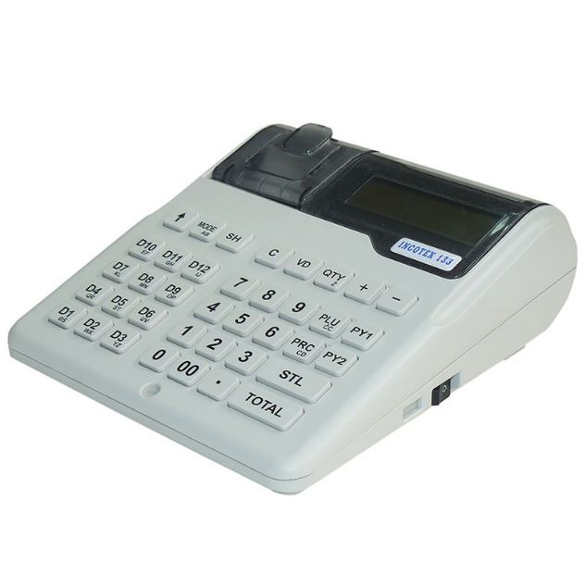
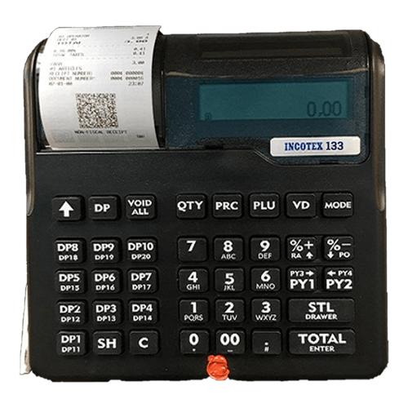
EFD MACHINES We. SALE & do REPAIR & MAINTANANCE.
INCOTEX - 181
INCOTEX - 133

Slide 25
REAL ESTATE.
This is a physical property, land, buildings and any improvement or natural resources attached to the land. It encompasses both residential properties( houses and apartments) and commercial properties( offices, retail spaces and industrial facilities).
JEM CAPITAL Real estate we offer variety of services to our clients. Some of the most common services include:
BUYING AND SELLING HOMES: we can help buyers find the right home for their needs and budget, and they can help sellers get the best possible price for their home.
RENTING AND LEASING HOMES: we can help landlords find tenants for their rental properties, and we can help tenants find rental properties that meet their needs.

Slide 26
REAL ESTATE
PROPERTY MANAGEMENT: we can manage rental properties on behalf of landlords. This includes collecting rent, screening tenants, and handling maintenance and repairs.
COMMERCIAL REAL ESTATE SERVICES: we can help businesses find and lease or purchase commercial properties. We can also help businesses sell their commercial properties.
INVESTMENT PROPERTY SERVICES: we can help investors find and purchase investment them when the time is right.

Slide 27
TRAININGS
QuickBook.
Advanced excel.
Auditing.
Accounting work and ethics.
Entrepreneurship.
Income management.
Tax compliance for business and NGOs.
Business Communication skills.

Slide 28
CONTACTS
Phone: +255 784 745 535
      + 255
Email: joshua@jemcapital.co.tz
info@jemcapital.co.tz

Slide 29
OUR SOCIAL MEDIAS
WhatsApp.
Instagram.
Twitter.
Facebook
USEFUL LINKS.
Tanzania Revenue Authority.
BRELA
TAUSI
B.O.T
NCST

